Slide 1
Exploratory Clustering in Dementia
Research Progress
Project Outlines
K-means and Agglomerative clustering
Characterize each cluster
Next Actions

Slide 2
Background
Alzheimer’s Disease (AD) is a devastating disease of dementia with rising prevalence, cost, and burden on patient and caregiver lives. Despite decades of research, effective treatment remains elusive, partly due to the complex and heterogeneous nature of the disease.
AD presents a longitudinal disease trajectory with various molecular and phenotypic features influencing risk and resilience. Lack of precise understanding of AD's biological mechanisms hampers treatment development and identification of risk groups.
Heterogeneity arises from diverse factors including genetic, environmental, lifestyle, and demographic influences.
Understanding and addressing AD heterogeneity is crucial for developing personalized treatment strategies.
Goals of the Project:
Explore clustering approaches to understand AD heterogeneity in the EMR.
Derive insights into heterogeneity due to clinical care and potential biotypes in AD.

Slide 3
Project Outlines
Purpose
This project will involve exploring clustering approaches to better understand AD heterogeneity in the EMR, and ultimately derive insights into heterogeneity in this population due to both clinical care and potential biotypes in AD.
Task 1 (Current task)
Explore clustering at different methods or levels in the high dimensional space
Task 2
Investigate impact of selection approaches and hierarchical clustering approaches (subtypes of clusters)
Task 3
Investigate clusters based on other dementia diagnosis labels (MCI, FTD, VD, etc.)

Slide 4
Project Outlines
Task 1 (Current task)
Explore clustering with different methods or levels in the high dimensional space
Progress:
Explore clustering approaches after the dimensional reduction by PCA: K-means and Agglomerative Clustering using iterative approach
Identify the optimal number of clusters
Characterize the clusters by odds ratio and Alluvial plot

Slide 5
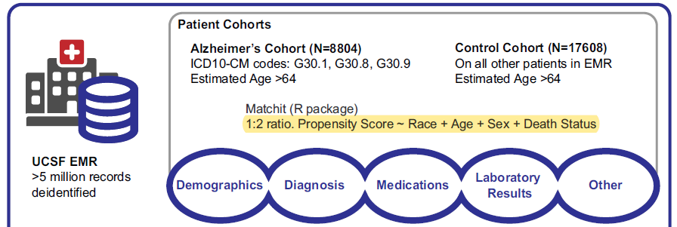
Data Analysis Flow
(n = 26,412)
Excluded: Patients without diagnosis (n= 5,081)
Analysis Data (n= 21,331)
Variable:
Diagnosis Name (Used for clustering, n= 47,431)
Age, Sex, Race, Death Status and AD flag (Not used for clustering)
Dimensional Reduction
PCA (number of components= 1750)
K-means Clustering
Agglomerative Clustering
UMAP Visualization

Slide 6
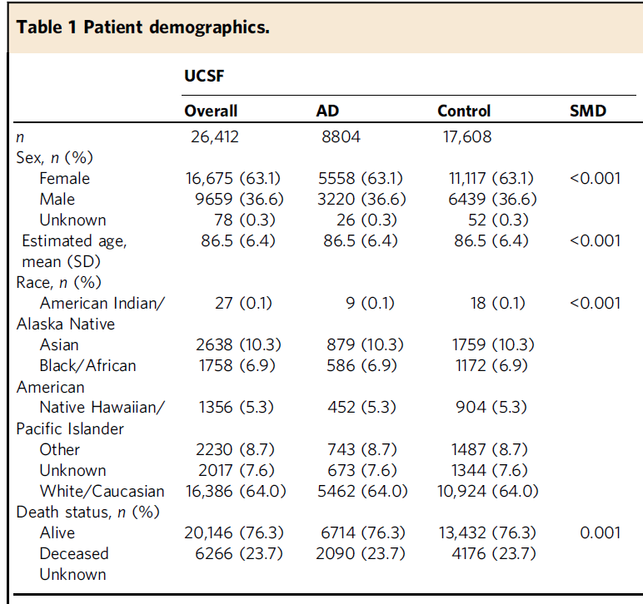
Demographics
Tang AS, Oskotsky T, Havaldar S, Mantyh WG, Bicak M, Solsberg CW, Woldemariam S, Zeng B, Hu Z, Oskotsky B, Dubal D, Allen IE, Glicksberg BS, Sirota M. Deep phenotyping of Alzheimer's disease leveraging electronic medical records identifies sex-specific clinical associations. Nat Commun. 2022 Feb 3;13(1):675. doi: 10.1038/s41467-022-28273-0. PMID: 35115528; PMCID: PMC8814236.

Slide 7
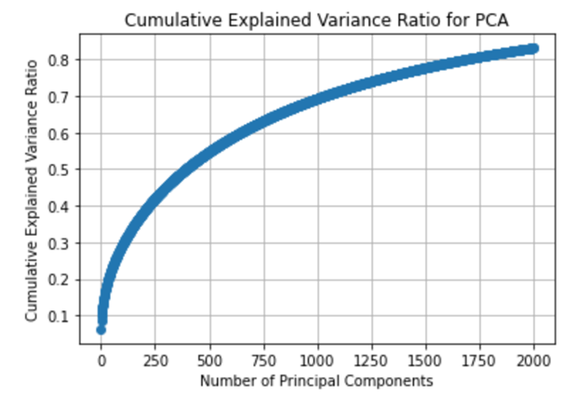
Dimensional Reduction by PCA
In general, components which cover 80% cumulative explained variance ratio should be included.
1750 components are chosen as the variables for the next clustering approach.

Slide 8
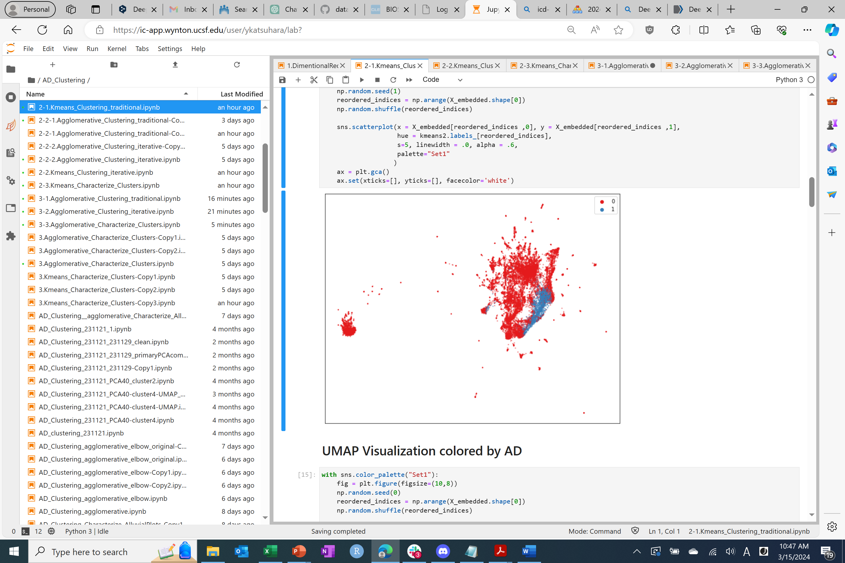
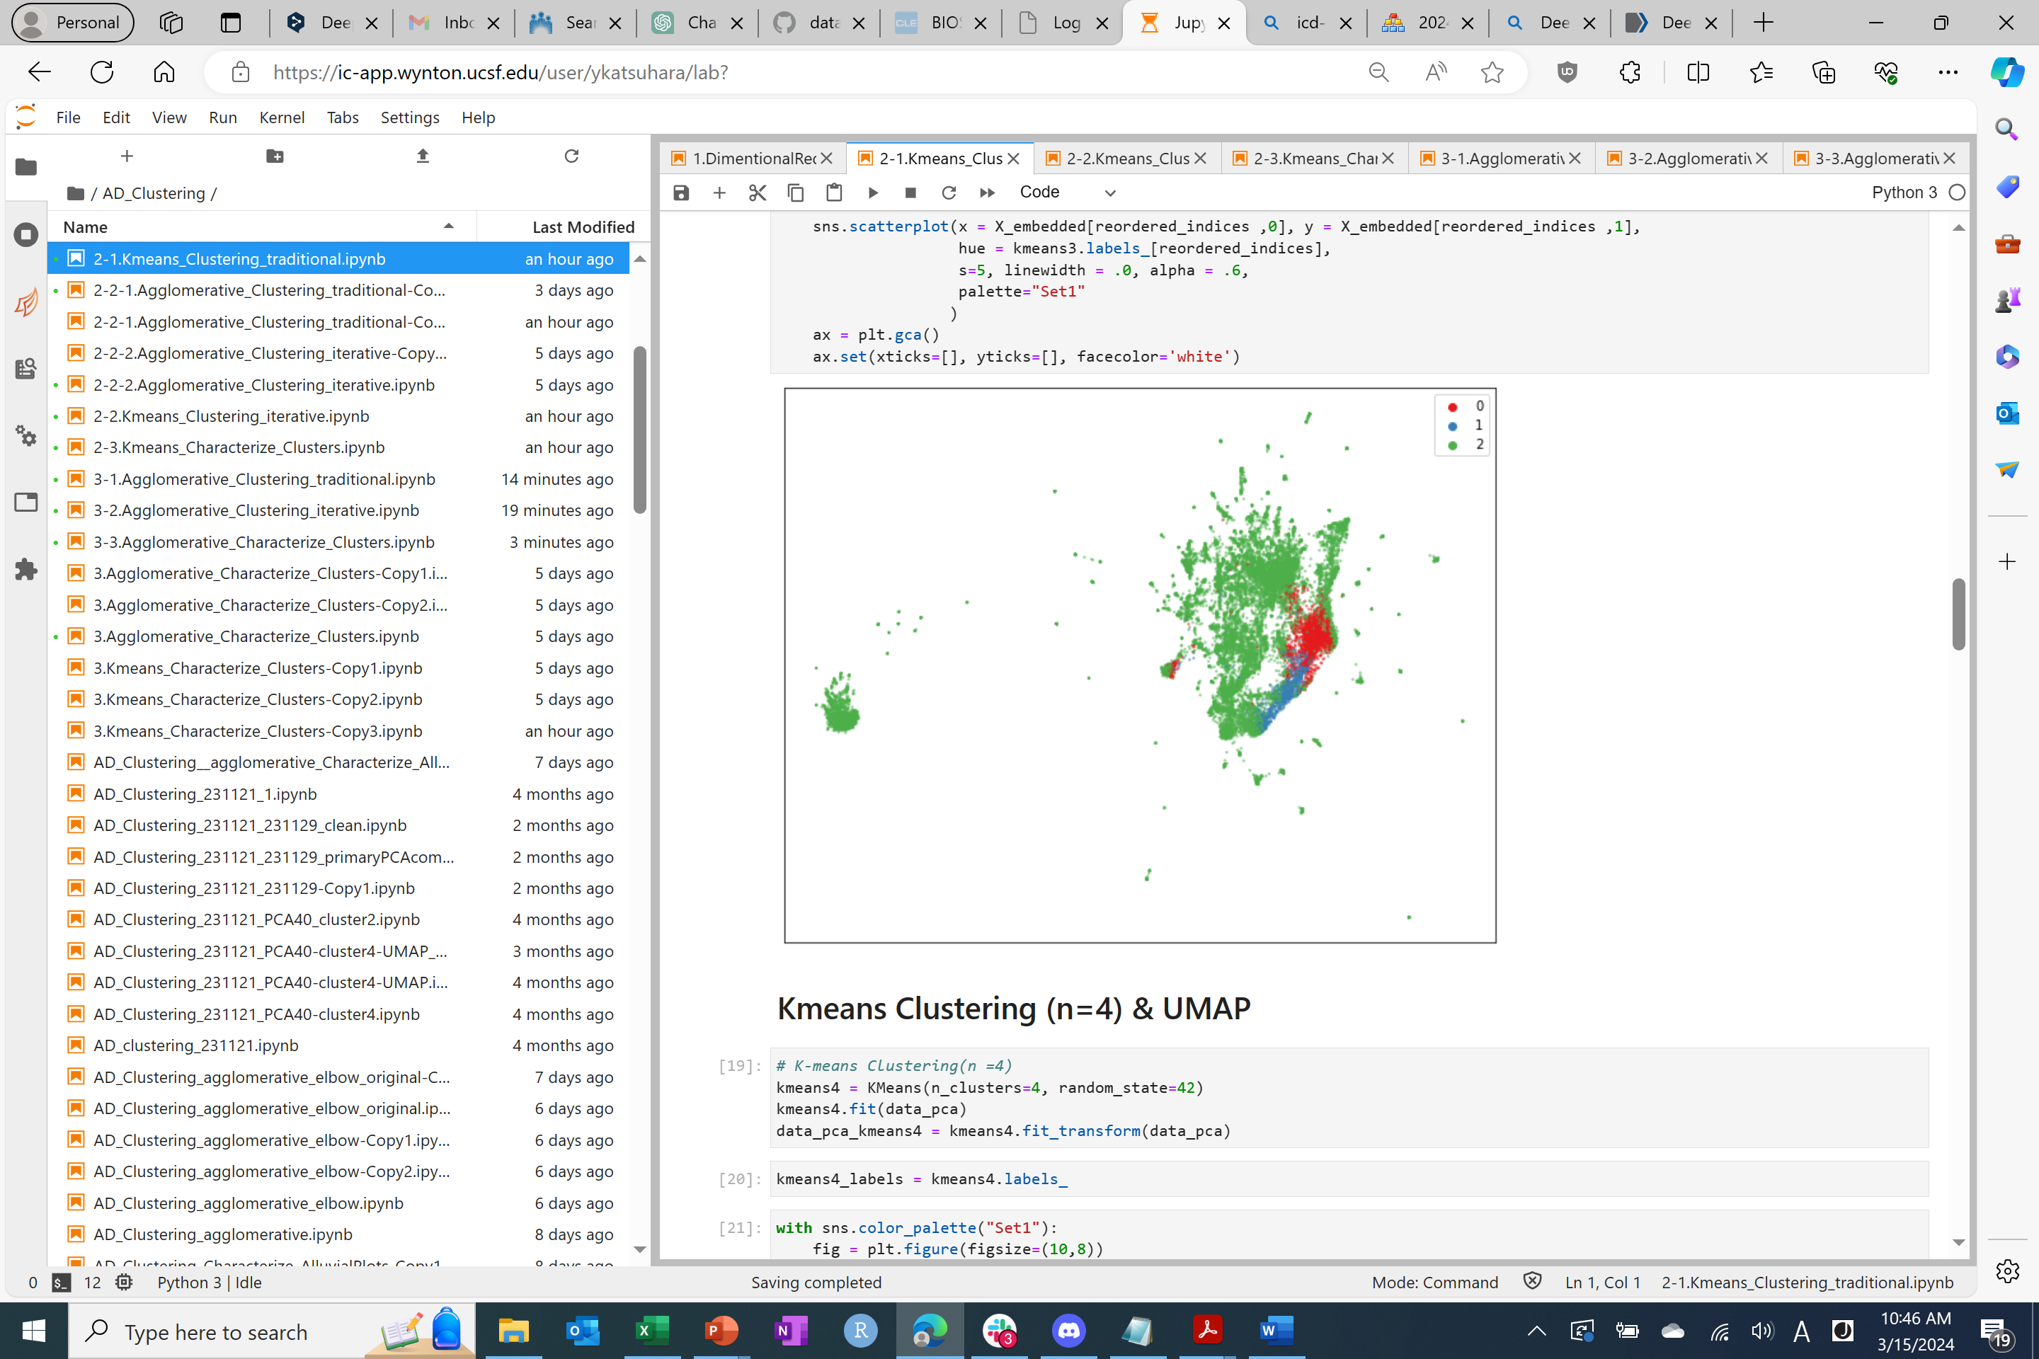
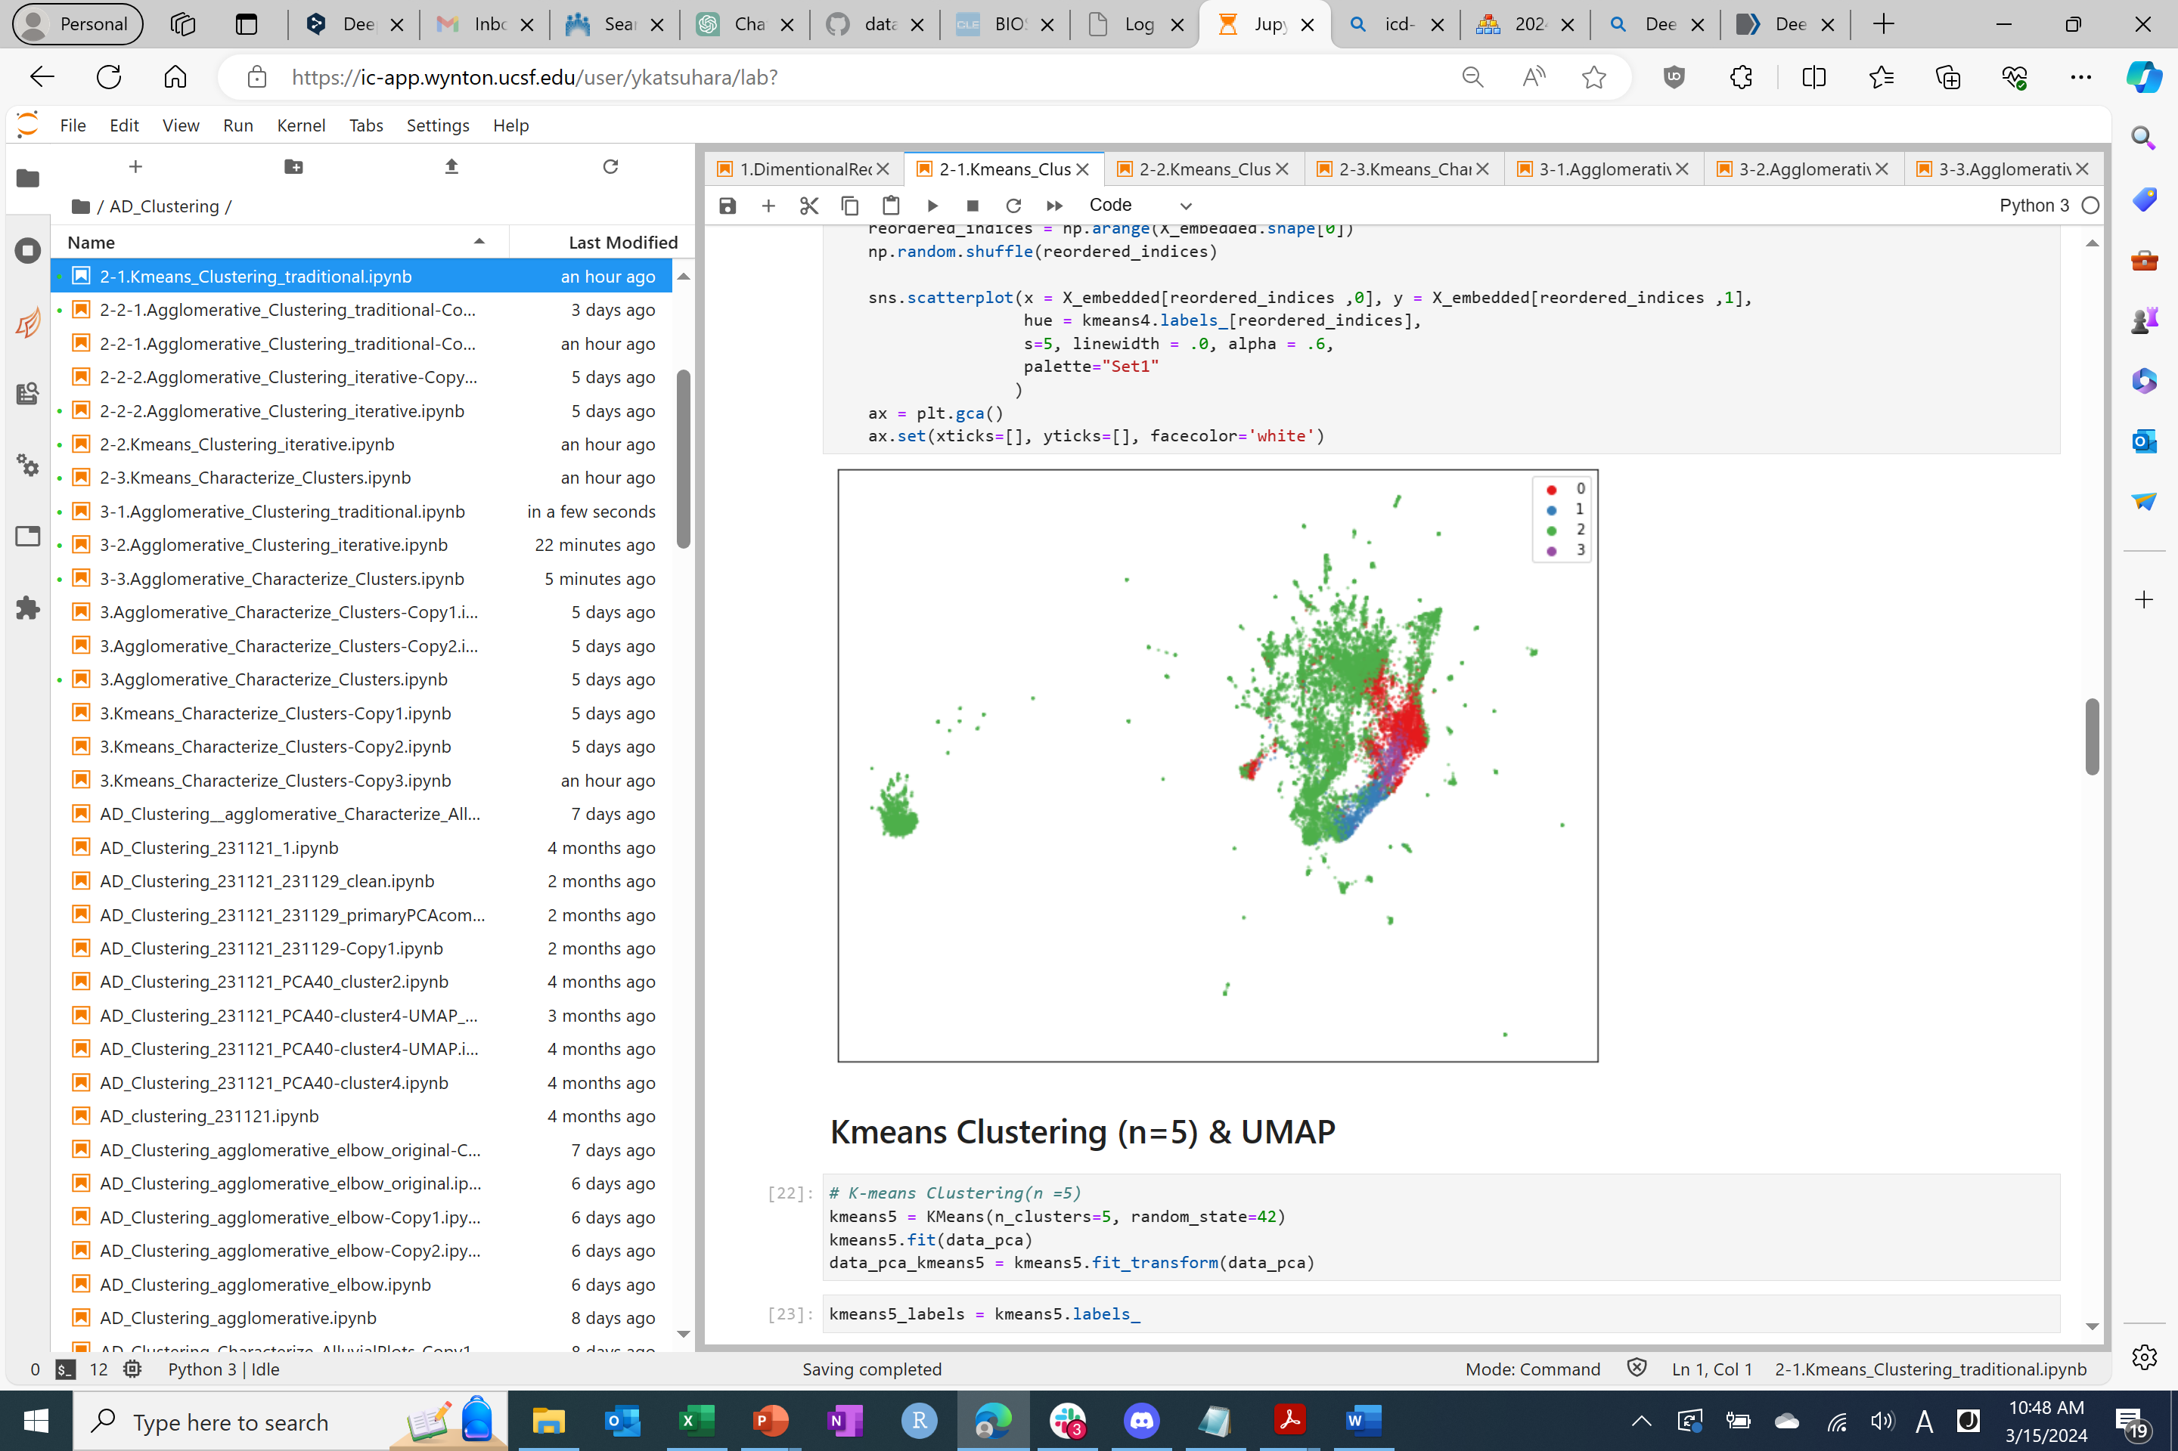
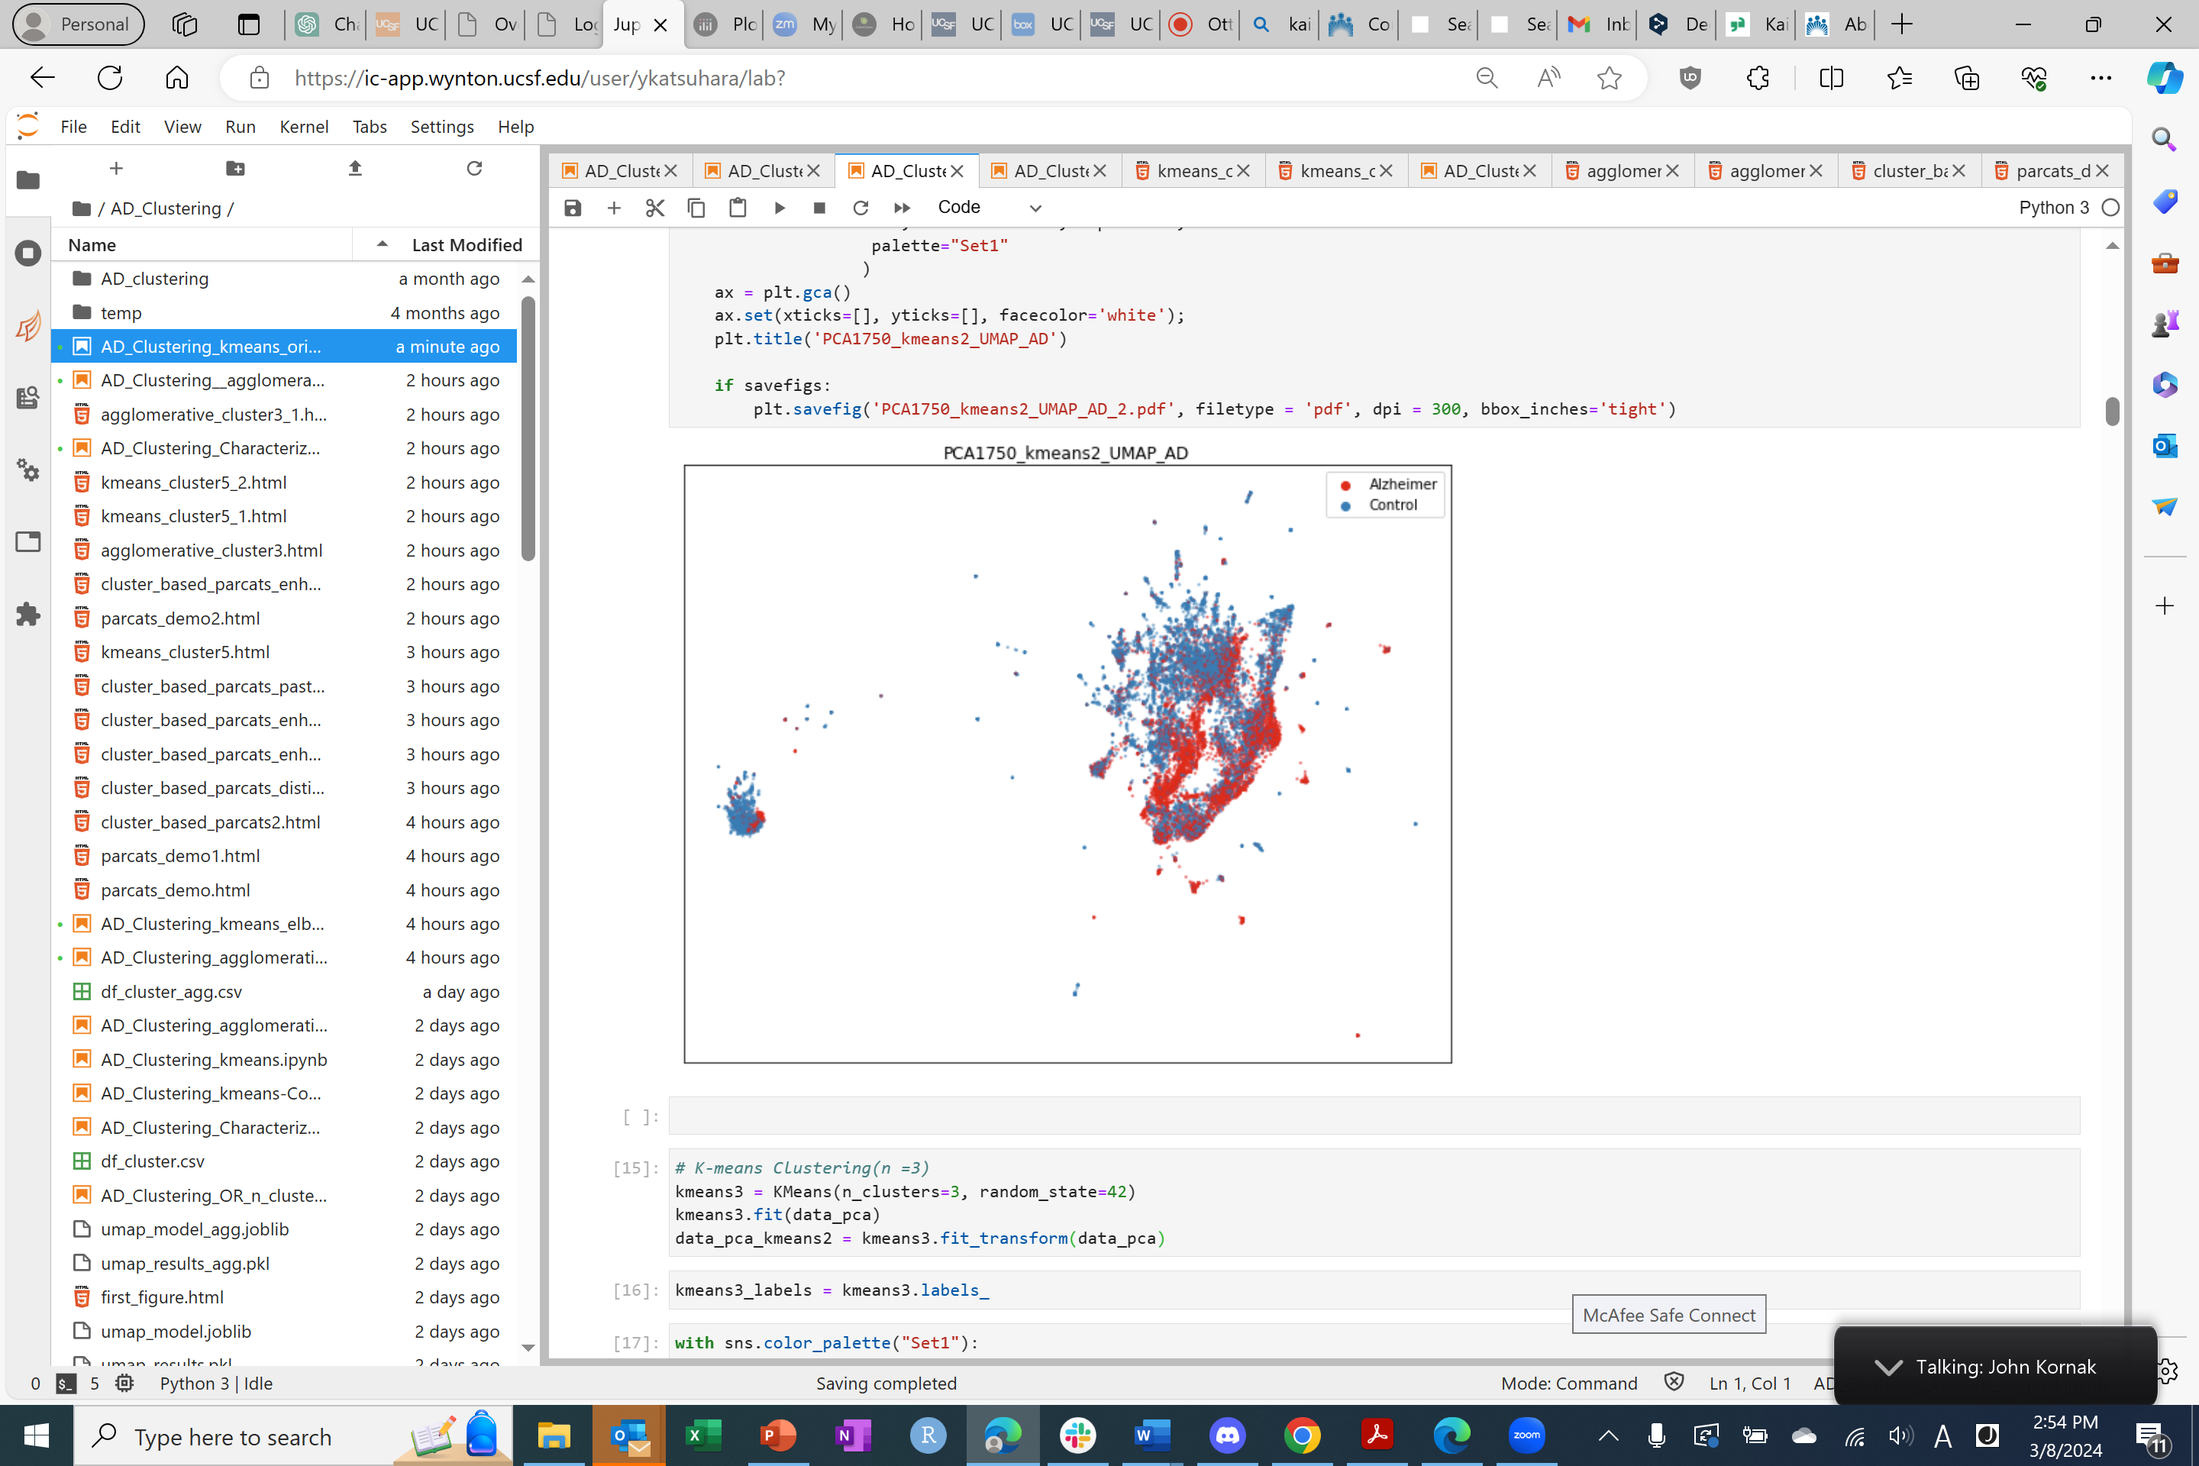
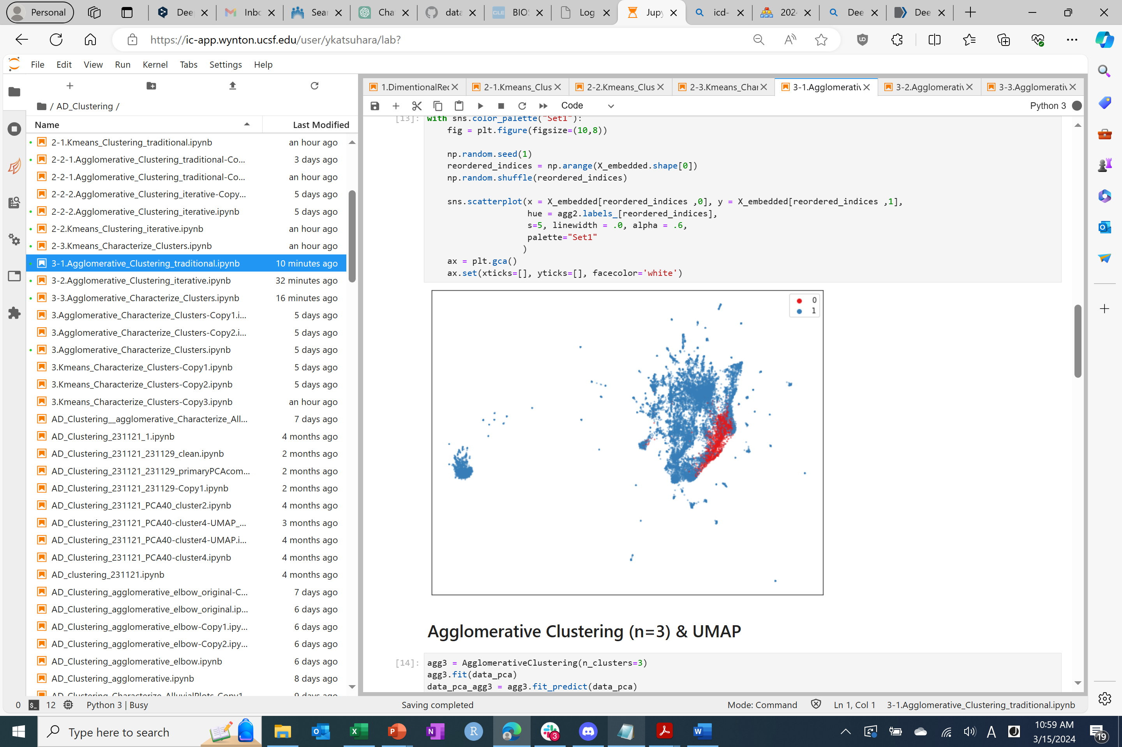
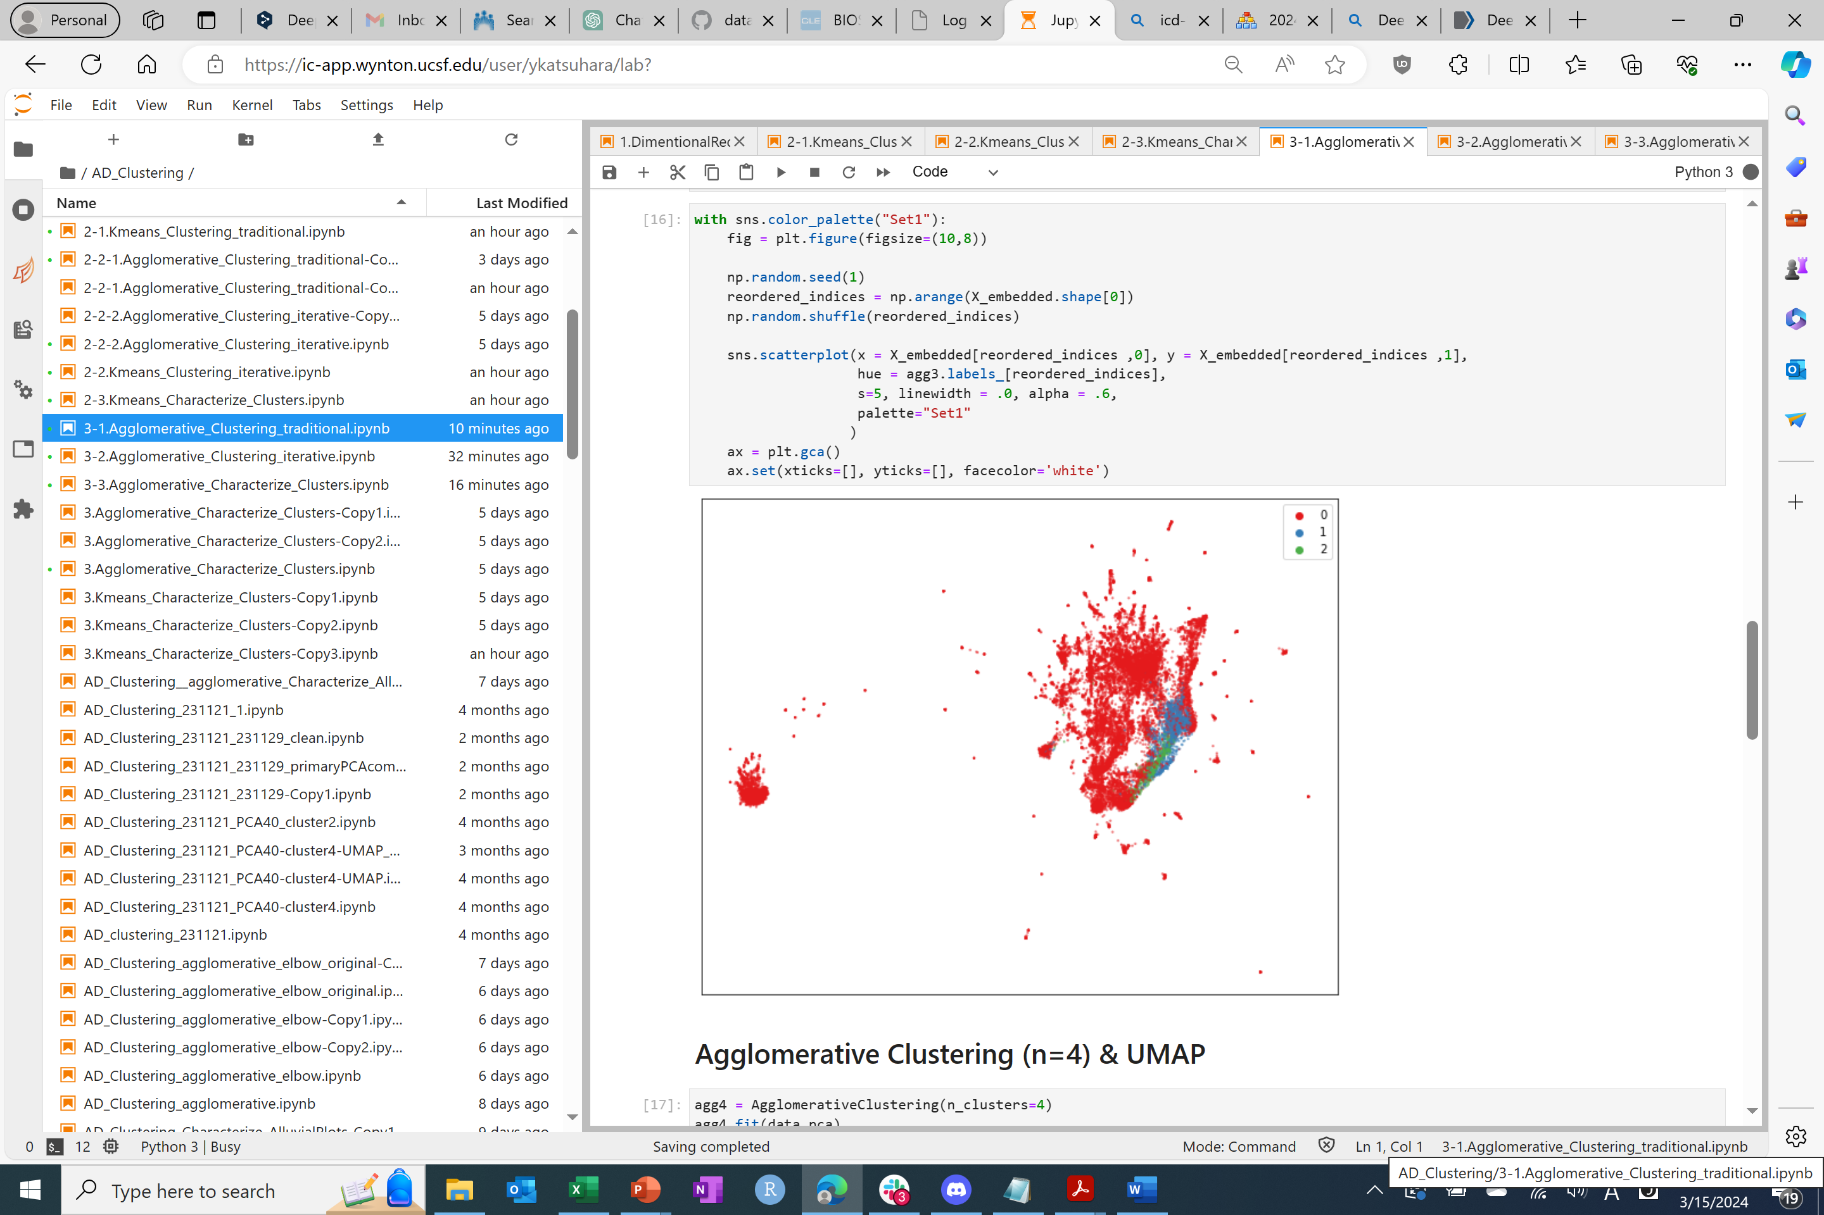
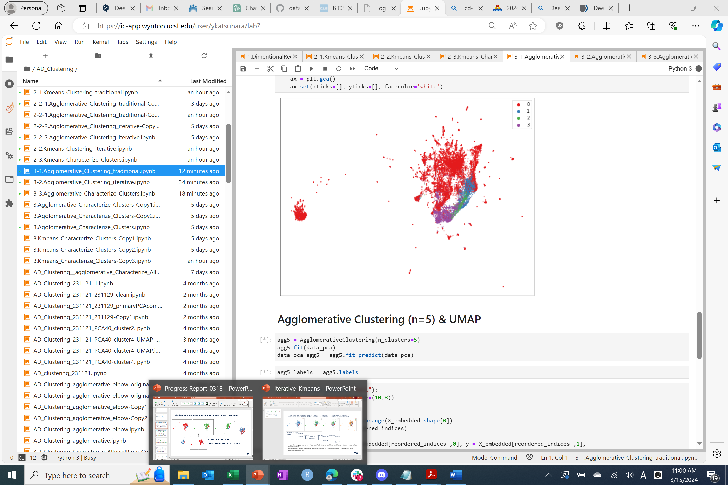
Explore clustering approaches : k-means & Agglomerative clustering
K-means clustering
Agglomerative clustering
Only specific area that has a high possibility of AD was divided into other clusters.
To make clusters from other areas, the iterative approach was conducted.

Slide 9
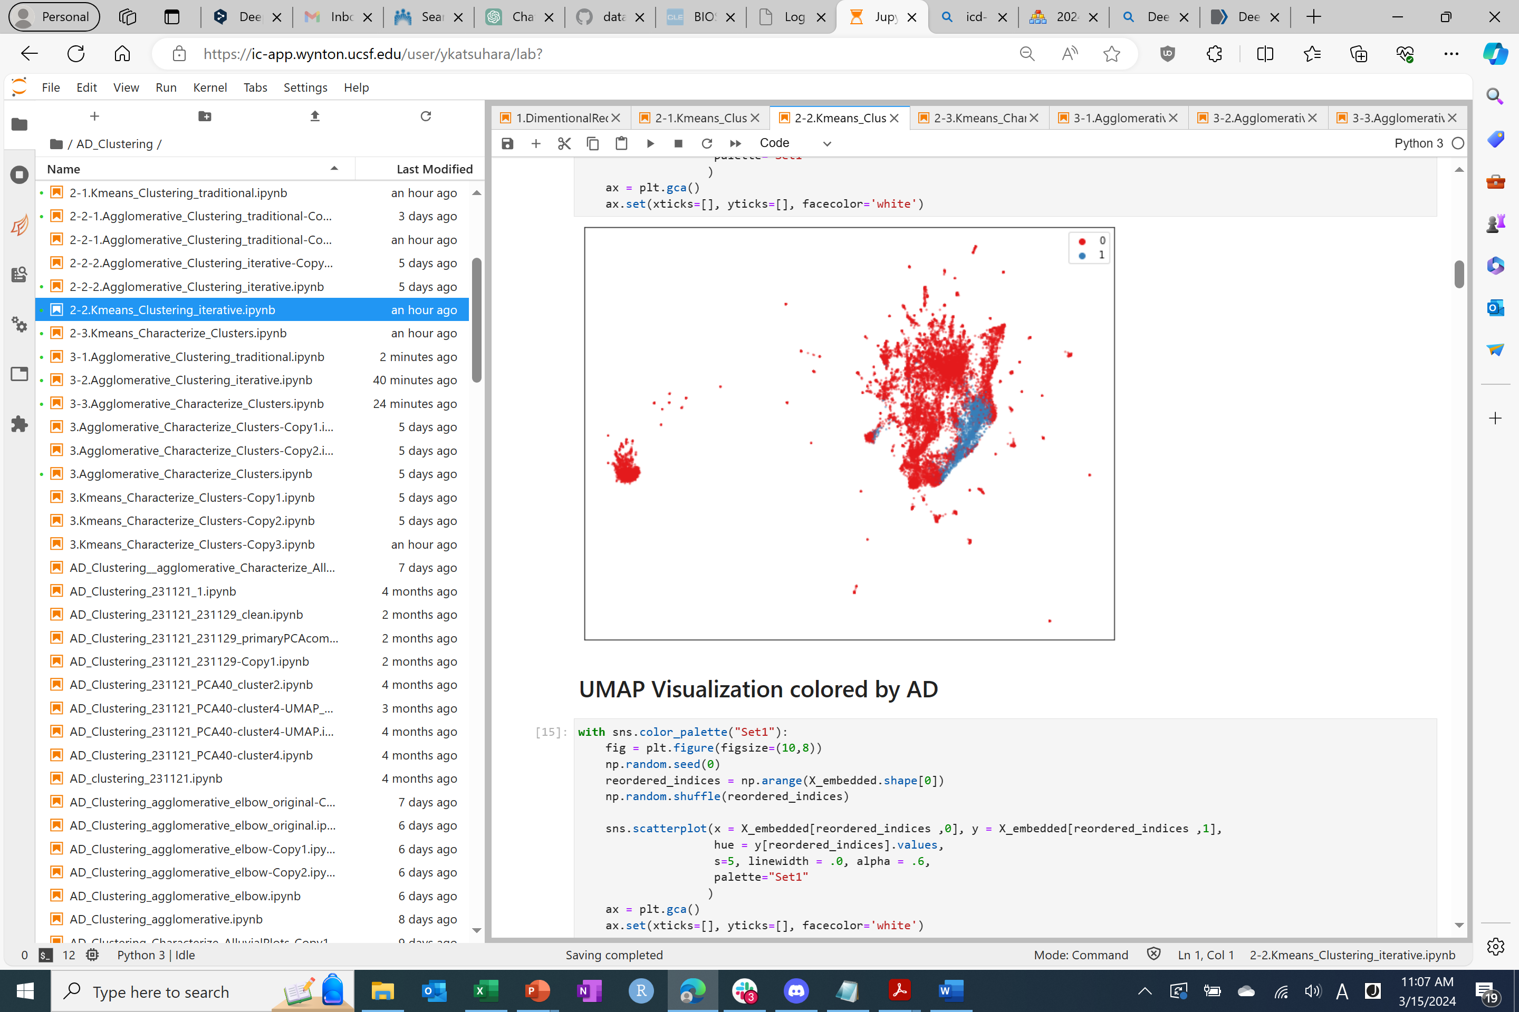
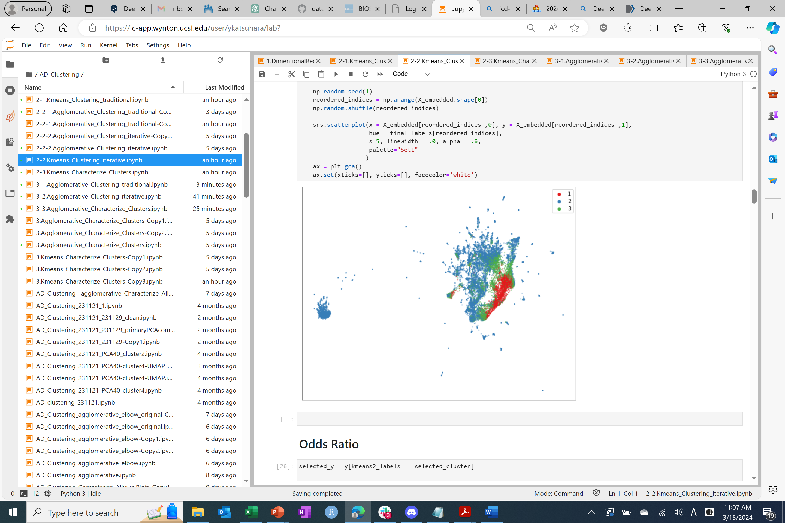
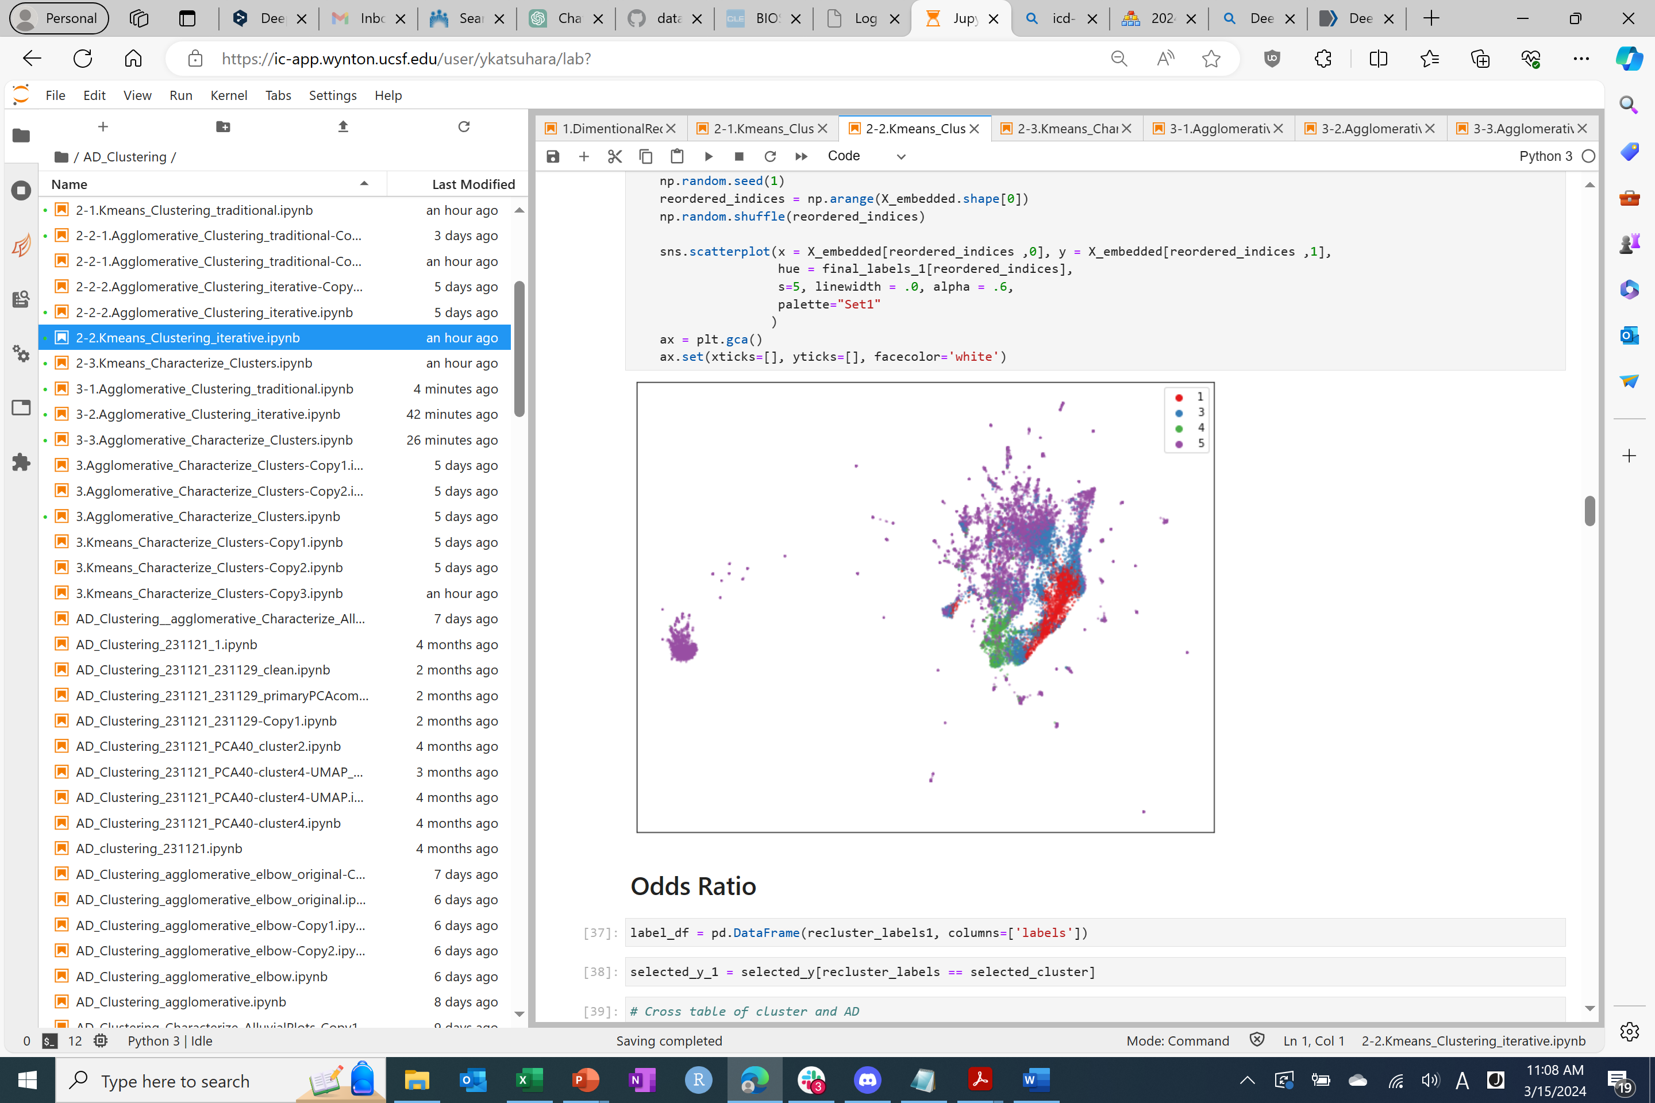
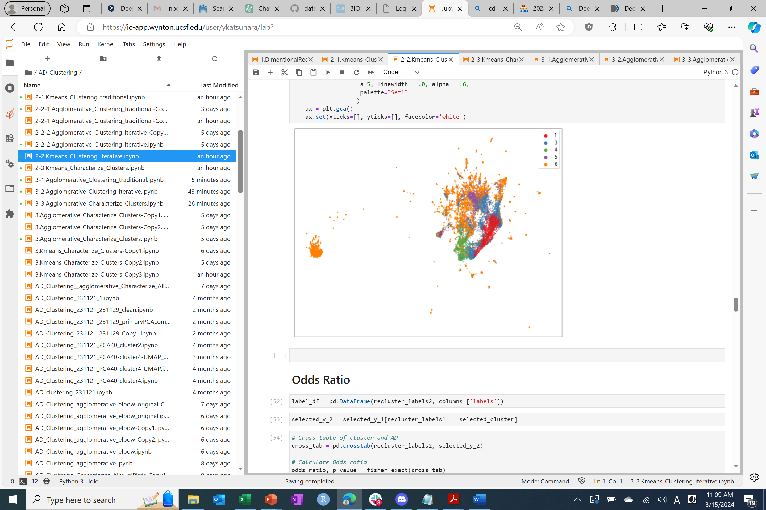
Explore clustering approaches : k-means (Iterative approach)
Analysis Dataset
K-means (k=2)
Cluster 0
K-means (k=2)
Cluster 2
K-means (k=2)
Cluster 4
Cluster 1
Cluster 3
K-means (k=2)
Cluster 5
Cluster 5
Cluster 6
Iterative clustering is conducted on a cluster identified with lower coefficients for Alzheimer’s Disease through logistic regression analysis.
This approach is chosen to categorize Alzheimer's disease data, which is widely dispersed on UMAP, into distinct subtypes comprehensively.

Slide 10
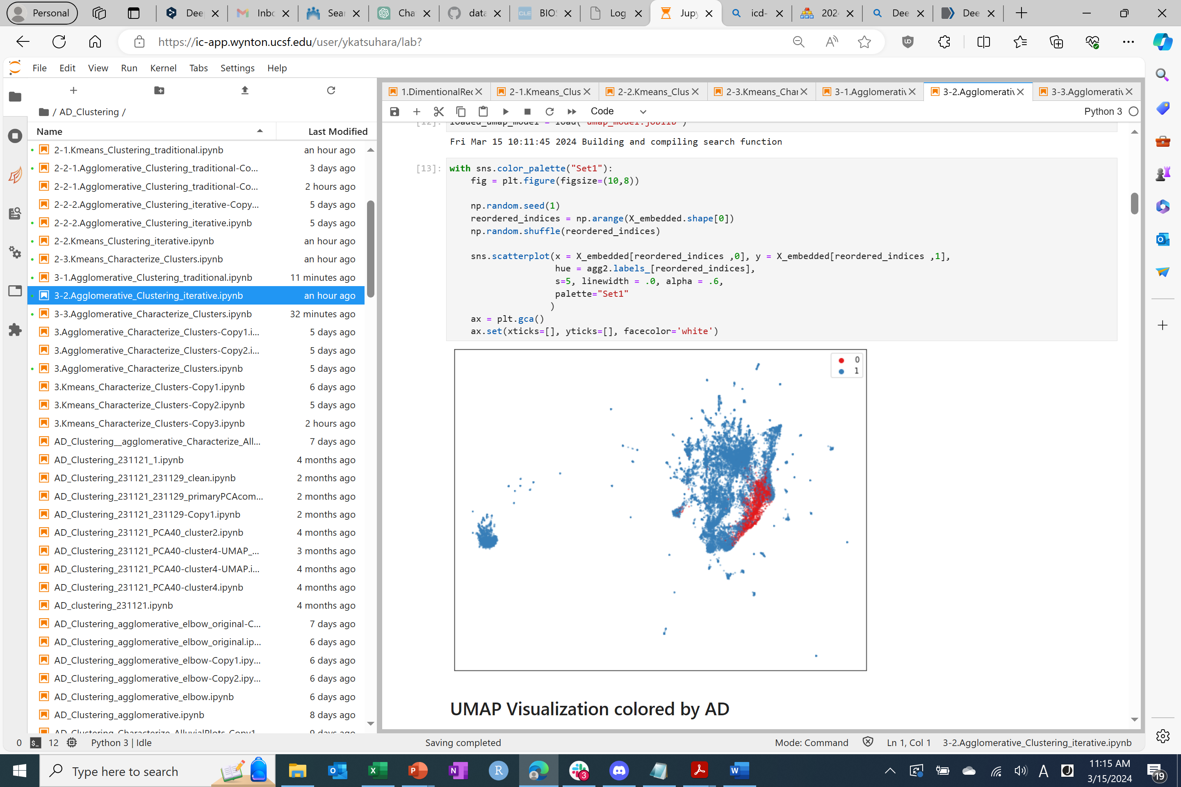
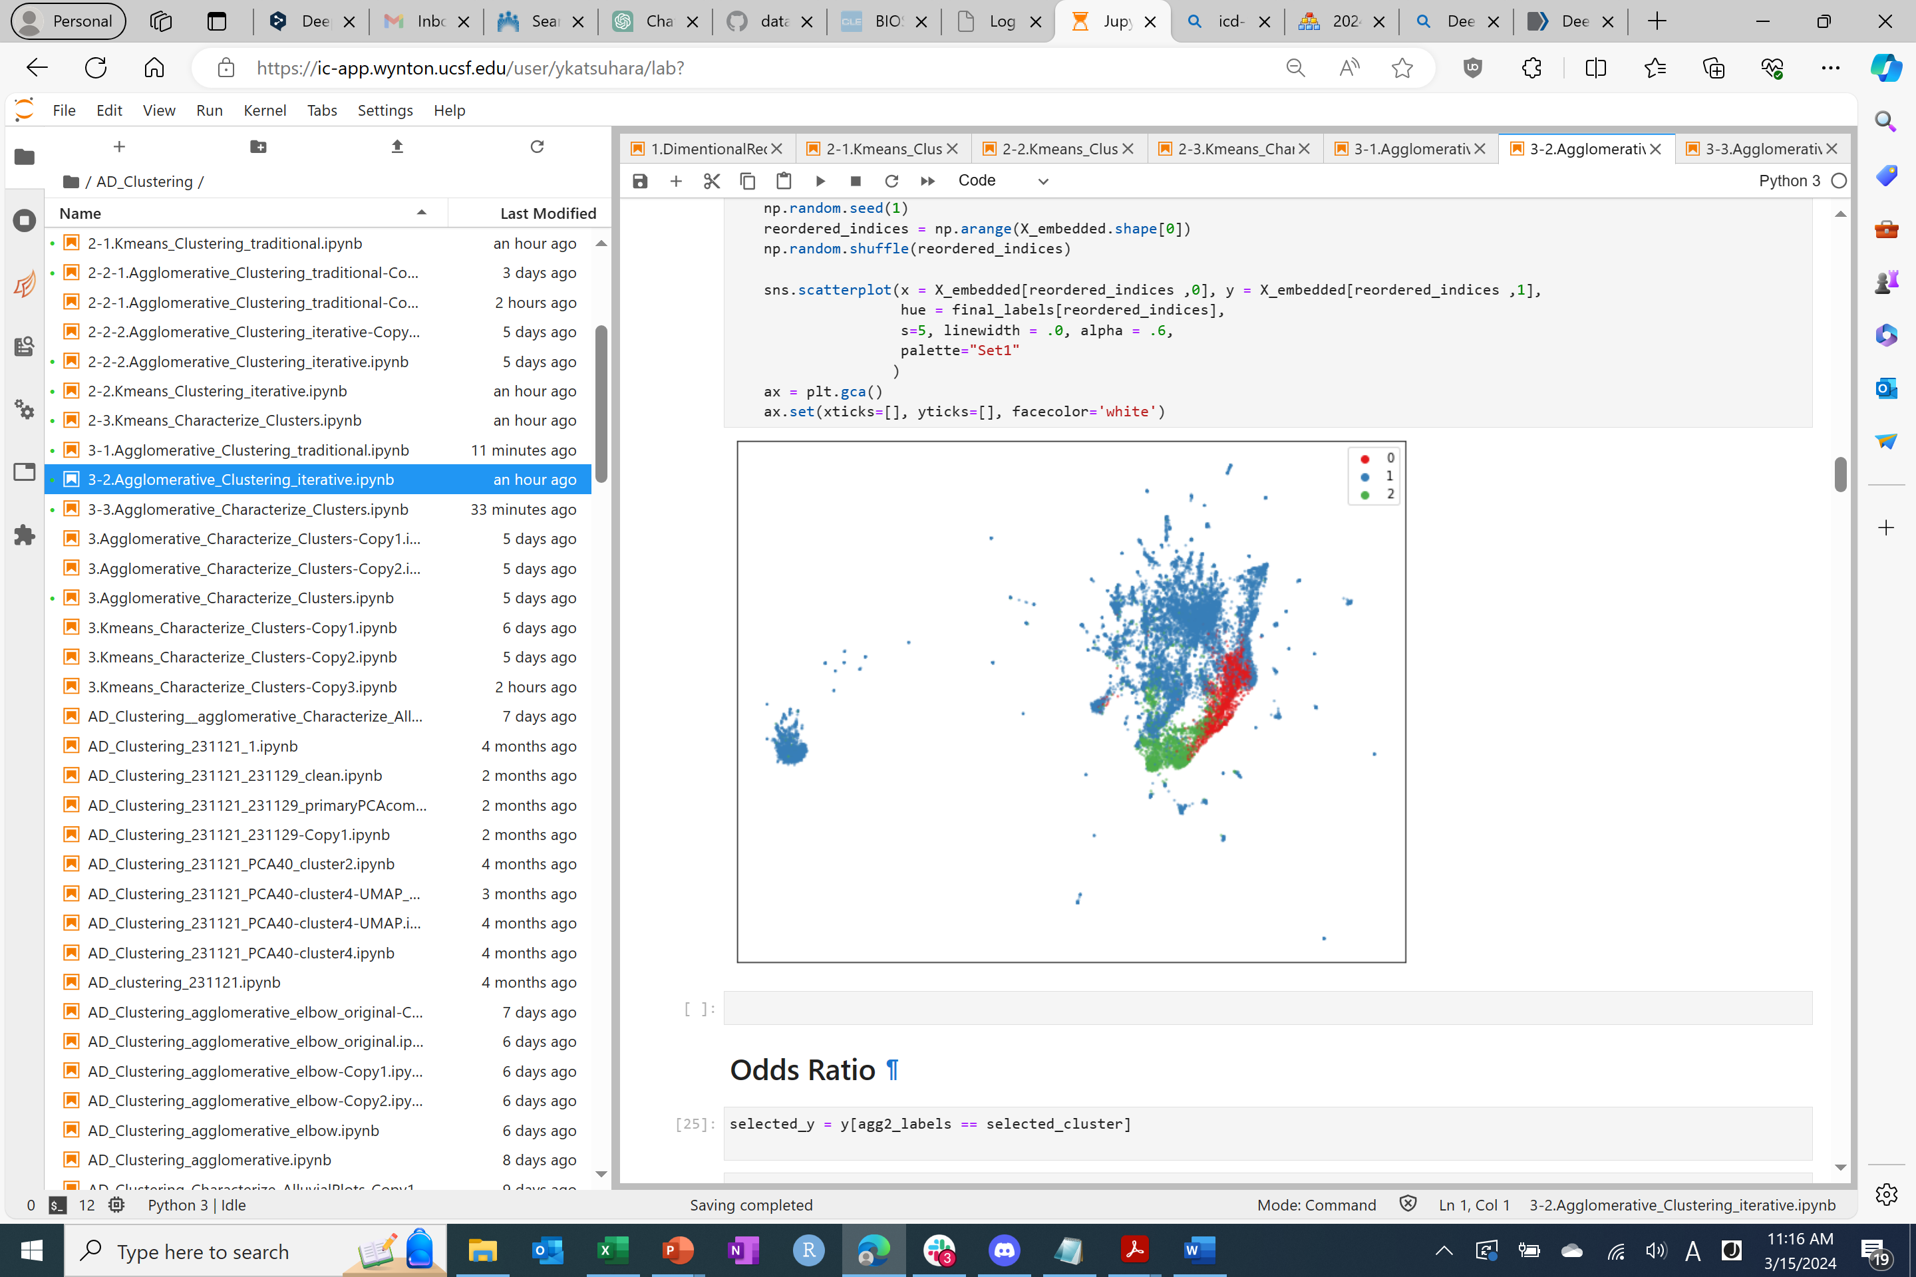
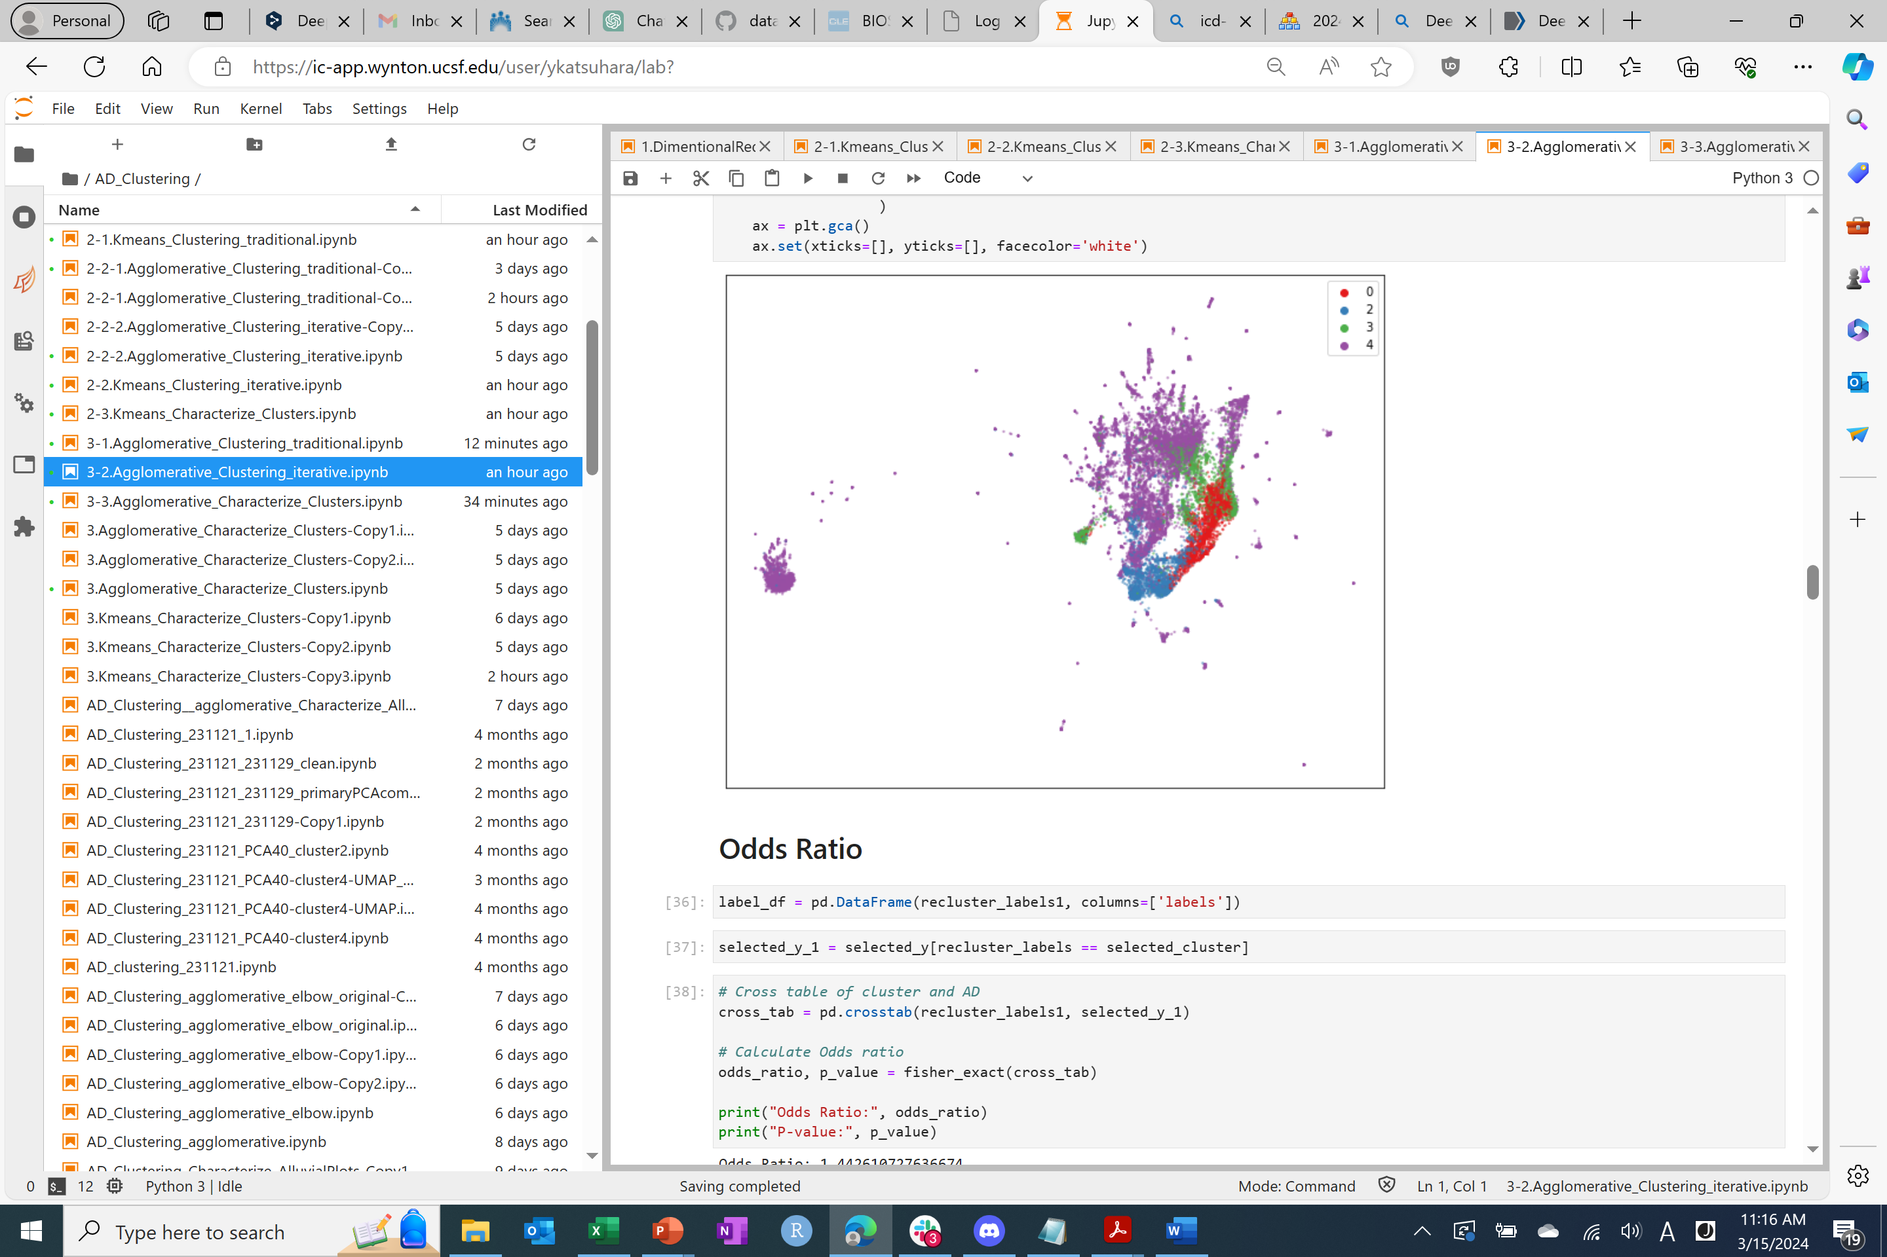
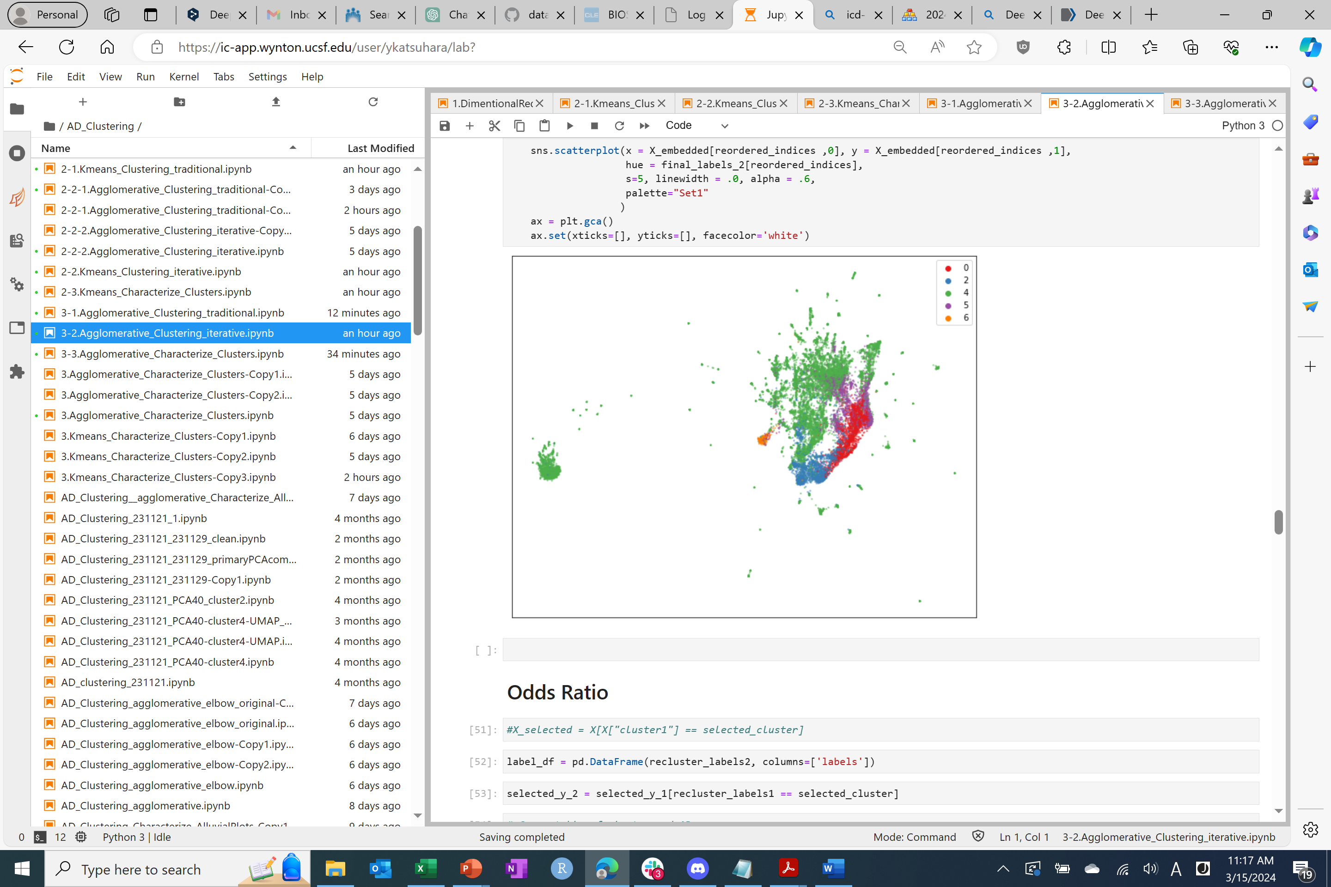
Explore clustering approaches: Agglomerative Clustering (Iterative approach)
What is the difference between the re-clustering and the traditional clustering approach?
Iterative clustering build a new cluster based on the only information that we want to focus on.
Iterative clustering is local optimization, classical clustering is global optimization

Slide 11
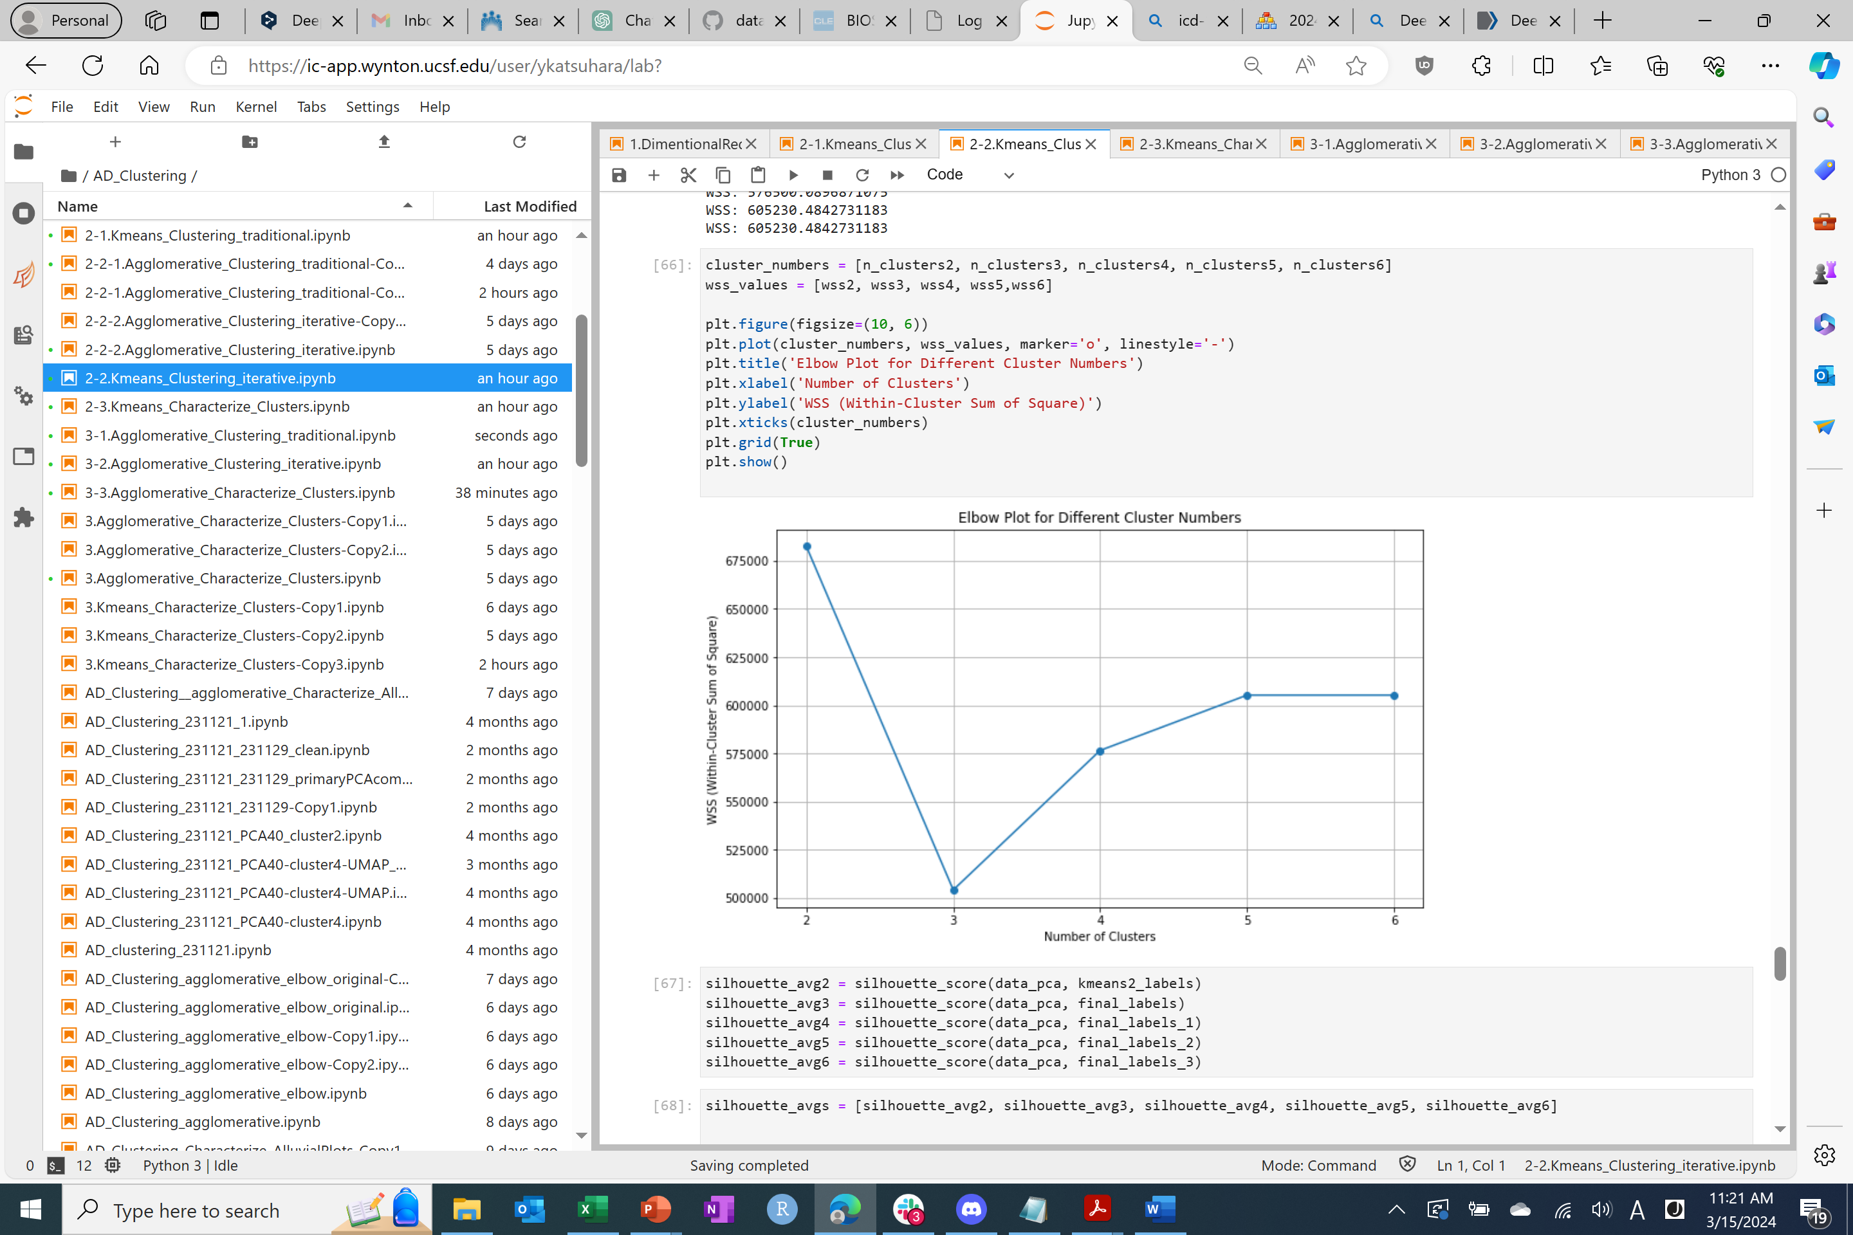

Identify the optimal number of clusters – Elbow Plot
K-Means Clustering
Agglomerative Clustering
The Elbow Method is a heuristic used in cluster analysis to determine the optimal number of clusters within a dataset.
By plotting the sum of squared distances (SSD) of samples to their closest cluster center, we can observe a point where the rate of decrease sharply changes, resembling an "elbow.“
The optimal cluster number: K-means approach is 3, Agglomerative approach is 4.

Slide 12
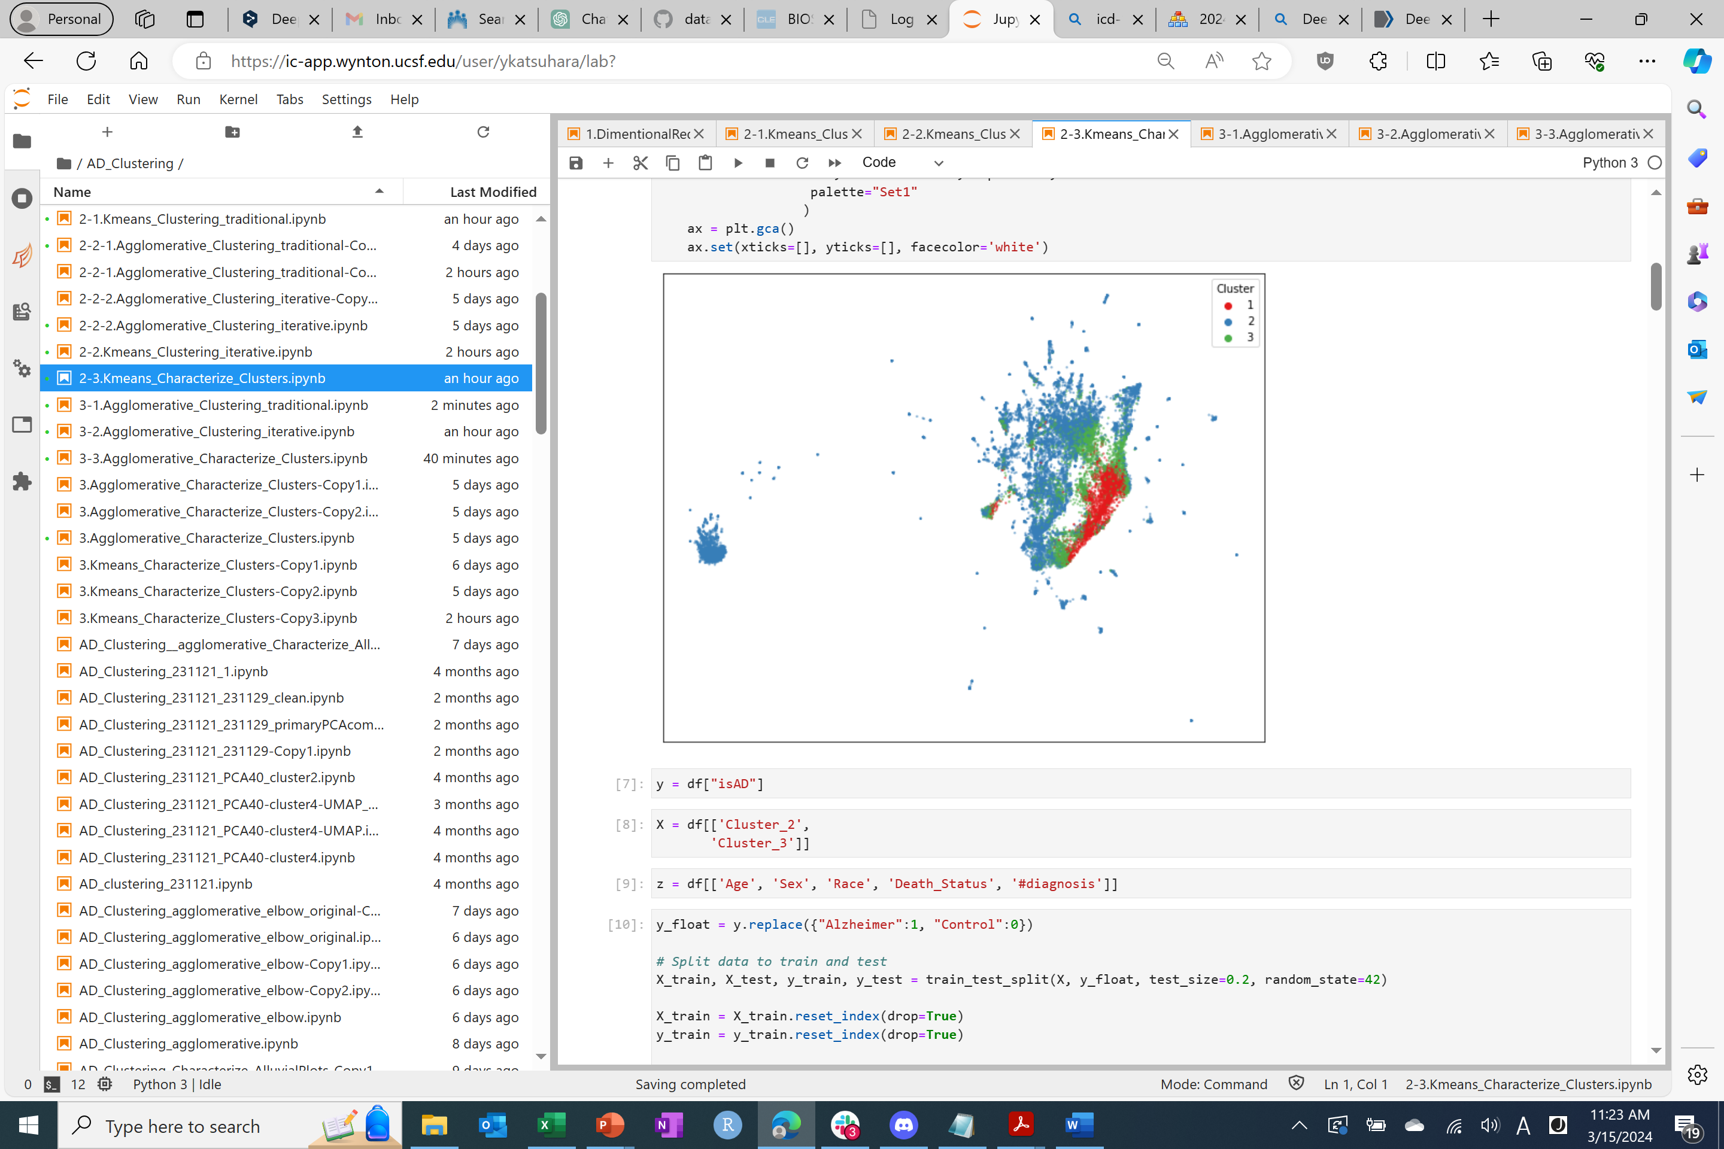
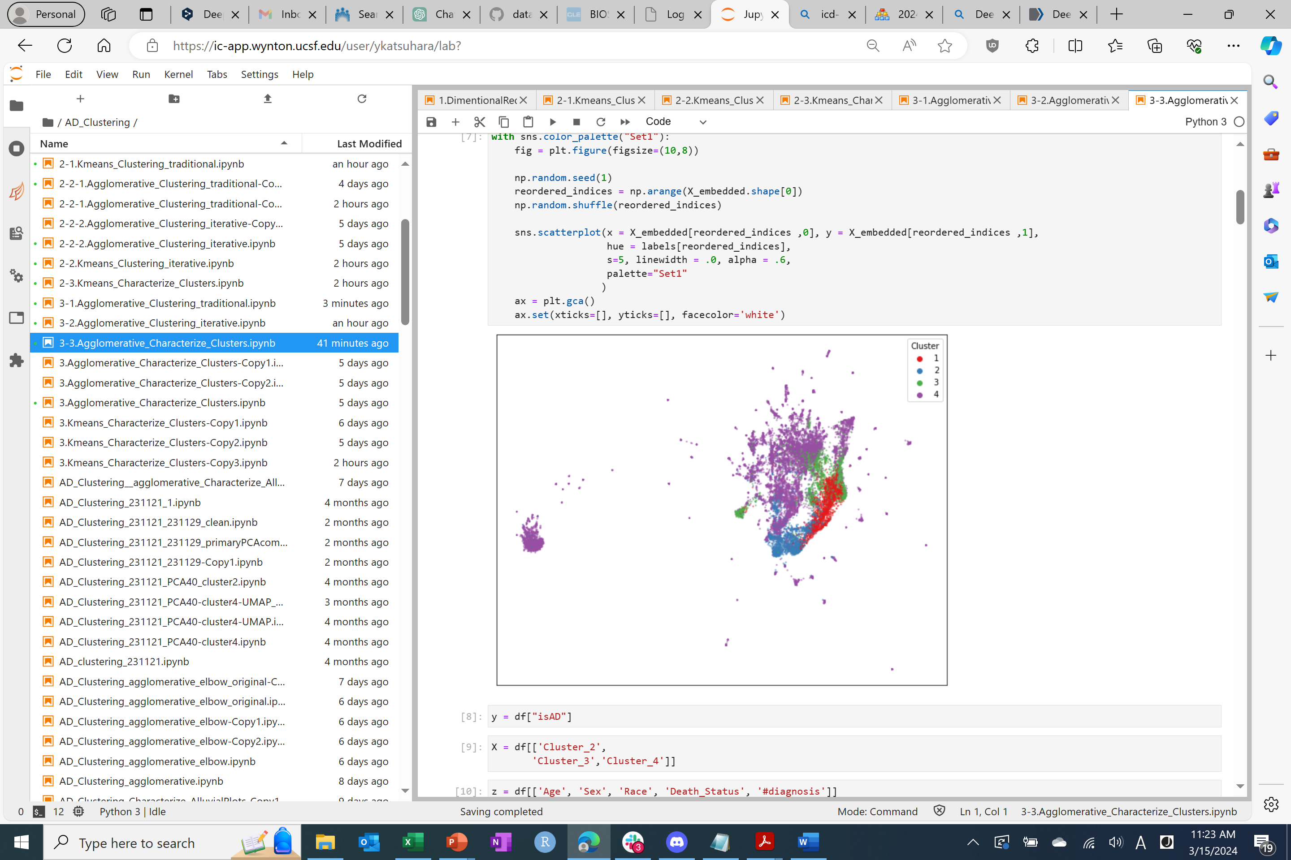
Identify the optimal number of clusters
K-Means Clustering
Agglomerative Clustering
With/without Alzheimer’s Disease

Slide 13
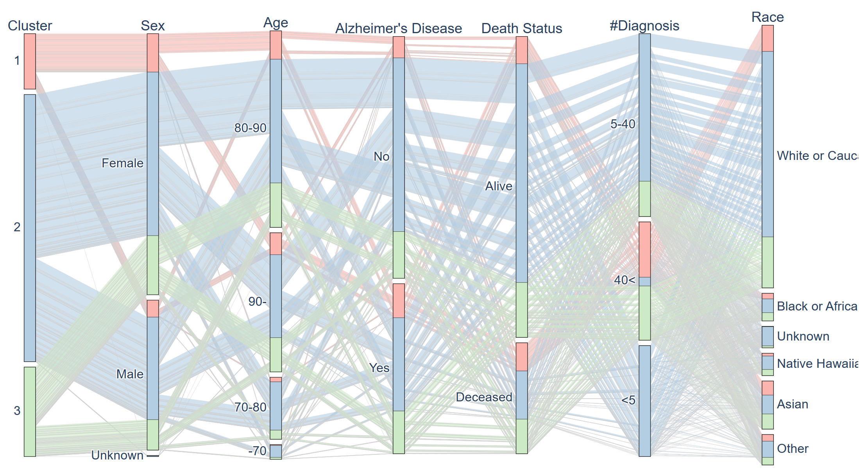
Characterize the K-means clusters
Odds Ratio for categorical variables
Coefficient and p-value for numerical variables
Character of each cluster:
Cluster 1 comprises predominantly females, older individuals, and those with complex comorbidities, including Alzheimer's Disease (AD) patients.
Cluster 2 represents the largest subtype and consists of younger individuals with milder conditions.
Cluster 3 encompasses relatively older individuals with complex comorbidities.
Alluvial plot:

Slide 14
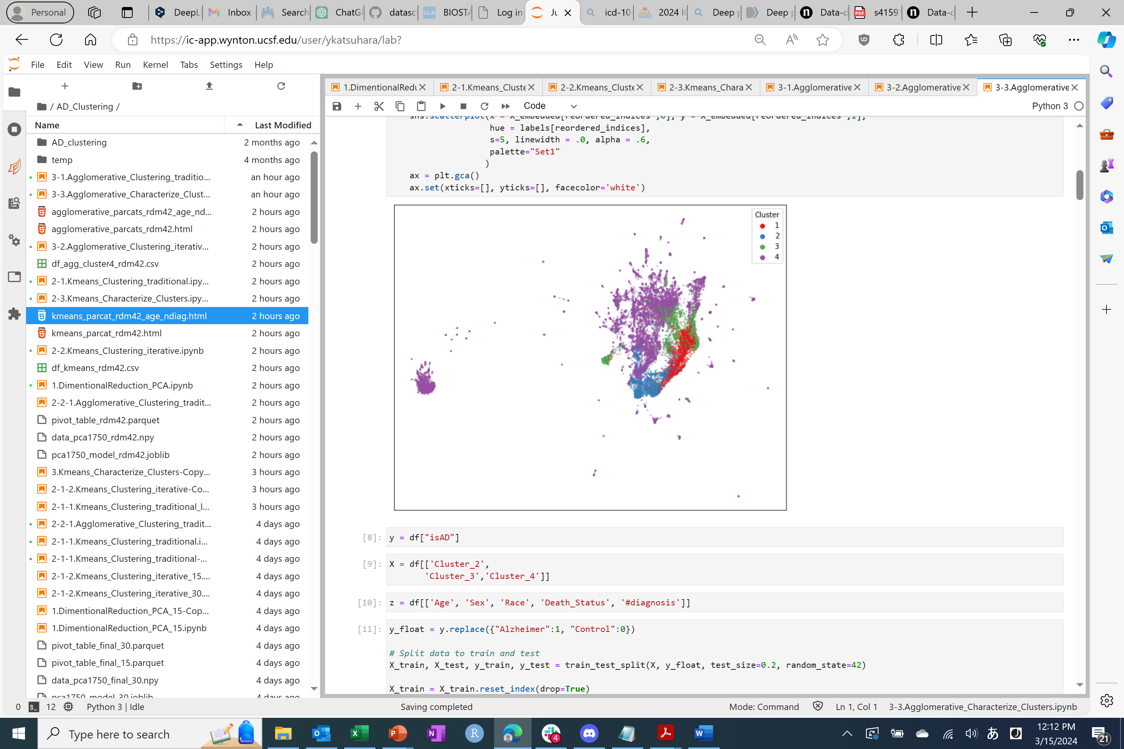
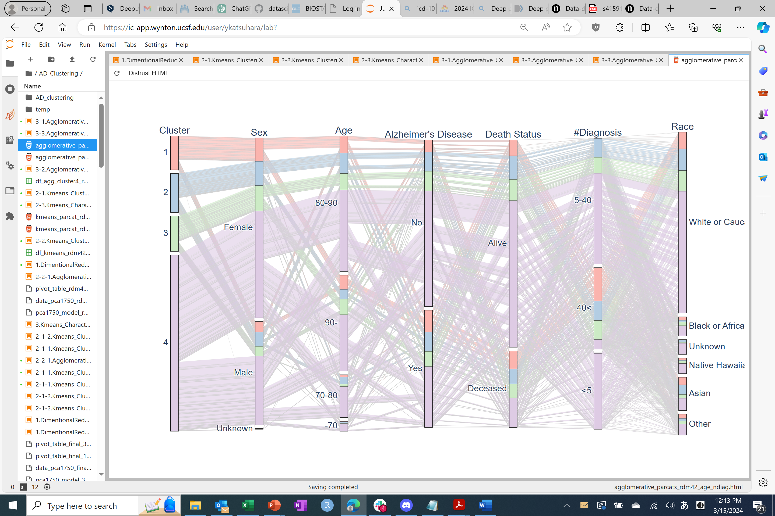
Characterize the Agglomerative clusters
Odds Ratio for categorical variables
Coefficient and p-value for numerical variables
Character of each cluster:
Cluster 1 comprises individuals with a higher prevalence of Alzheimer's Disease (AD), predominantly female, older in age, and presenting with complex comorbidities.
Cluster 2 consists of relatively younger individuals with complex comorbidities.
Cluster 3 encompasses older females in greater proportion.
Cluster 4 consists of relatively younger individuals with fewer complex comorbidities.
Alluvial plot:

Slide 15
Conclusion
This study dissects the complexity and heterogeneity of Alzheimer’s Disease into three or four subphenotypes based on the EHR using clustering approach.
The clusters may not be immediately biological relevant, but they have possibilities to explain the heterogeneity of both social/behavioral and biological influences.
A thorough interpretation of these clusters is necessary to unveil the intricate relationship between the clusters and various biological, social, and behavioral factors.

Slide 16
Next Actions
Exploring optimal number of clusters
Based on the characteristic of each clusters
Back to the classical clustering approach:
1. Find optimal number of cluster using the elbow plot and characterize the clusters
2. Re-clustering the largest cluster
Focus on AD patient only
Characterize using comorbidities (e.g., diabetes, hypertension, hyperlipidemia)
Check the important features of each PCA component/cluster
Labeling MCI, Parkinson’s disease etc.

